Slide 1
GIS应用开发
Developing GIS Applications with ArcObjects using C#.NET
江西省研究生优质课程
主讲：兰小机 教授
Email : landcom8835@163.com
QQ ：305333315
      课件： ftp://218.87.136.94/

Slide 2
Chap.4 几何对象与空间参考 （4学时）
  几何对象概述
  使用几何对象
  空间参考
  地理变换

Slide 3
4.1 几何对象概述
Geometry对象用于表达要素(Feature)或图形元素(Graphic Element)的几何形状。
ArcGIS的几何对象被分为两个层次
  高级几何对象：用于定义要素的几何形状；
  构件几何对象：用于构建高级几何对象。

Slide 4
高级几何对象包括以下类型：
  Point：具有X、Y坐标值，以及可选的属性，如高程(Z值)，测量值(M)和ID号。
  Multipoint：是无序点的群集，它用于表示具有相同属性设置的同一组点。
  Polyline：是一个有序路径(Path)的集合，这些路径既可以是连续的，也可以是离散的。
  Polygon：是环(Ring)的集合，环是一种封闭的路径。Polygon可以由一个或者多个环组成，甚至环内套环，形成岛环的情况，但是内外环之间不能重叠。
  MultiPatch ：用于描述三维几何形体面。

Slide 5
几何构件：
  路径(Path)、环( Ring)、线段( Segment)、三角形带( TriangleStrip)、三角形扇( TriangleFan)及三角形用于构建多段线(polyline)、多边形(polygon)和多面体(MultiPatch).
  Polylines contain paths, polygons contain rings and MultiPatches contain TriangleStrips, TriangleFans, triangles, and rings.
  Paths and rings are sequences of vertices connected by segments.
  A segment is a parametric function that defines the shape of the curve connecting its vertices. Segment types include CircularArc, Line, EllipticArc, and BezierCurve.
  Envelope：Envelopes describe the spatial extent of other geometries，是一个矩形，它用于表示要素的空间范围。它覆盖了几何对象的最小坐标和最大坐标、Z值和M值的变化范围。
GeometryBags provide operations on collections of geometries.

Slide 6
一个几何对象的每个顶点，除了有XY坐标值外，还可以有其它可选属性，如Z值、M值和ID。
  IZAware
  IMAware
  IPointIDAware
  IPoint pnt = new PointClass() as IPoint;
  pnt.PutCoords(1, 1);
  IZAware zAware = pnt as IZAware;
  zAware.ZAware = true;
  pnt.Z = 11.1;

Slide 7
Multipoint， polyline， polygon和 MultiPatch几何对象在它们的几何形状上都有约束条件
  如多边形的内部必须明确定义，且必须与之外部分开。
  当几何对象上的所有约束条件都满足时，我们说这个几何对象是简单的几何对象；当有一个约束条件未满足或不知道这个约束条件是否满足时，我们说这个几何对象是非简单（non-simple）的几何对象。
  ITopologicalOperator、IPolygon2～IPolygon4和IPolyline2～IPolyline5接口中提供了检测和强化几何对象简单性的操作。

Slide 8
几何对象, 特别是线段类型，有一套丰富的方法用于定义它们的位置。
  例如，IConstructCircularArc 接口中有不同的方法定义圆弧线段。典型情况下，名字中包含“construct”的接口或方法使用多个输入参数来完全定义目标几何对象。

Slide 9
高级几何对象支持经典的集合运算来产生新的几何对象，这些集合运算包括集合的并(union)、交( intersection)、差( difference)和对称差分(symmetric difference，也即异或运算)。这些操作定义在ITopologicalOperator接口中，且通常情况下这些运算一次操作两个几何对象，但其中的ConstructUnion 运算可作用于多于2个几何对象。
高级几何对象还支持IRelationalOperator 接口，其中定义了用于检测2个几何对象之间的空间关系方法，如检测2个几何对象是否相离（disjoint）、是否相接（touch）、是否包含（contain）等，这些方法返回布尔类型的值。

Slide 10
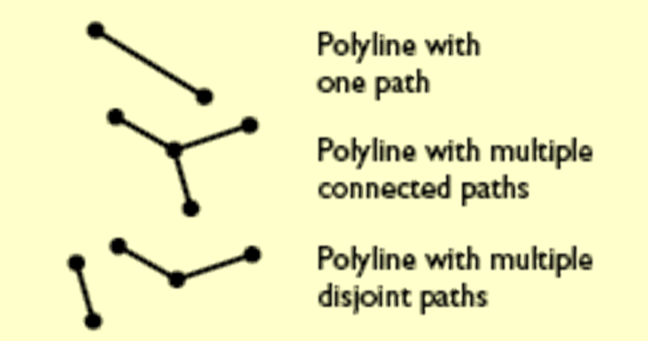
Polyline(多段线)对象
Polyline(多段线)对象是相连或不相连的路径对象的有序集合，它可以分别是单个路径、多个不相连的路径和多个相连路径的集合。

Slide 11
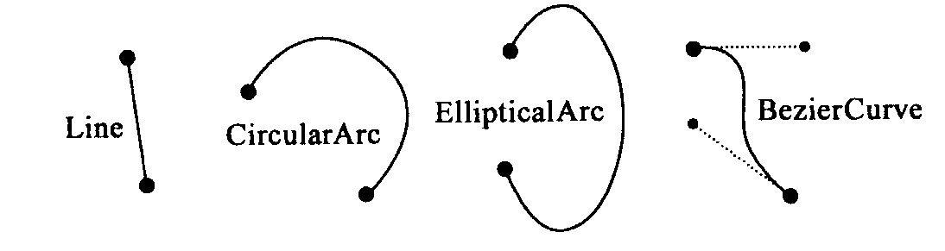
路径(Path)是连续Segment对象的集合，除了路径的第一个和最后一个Segment外，每一个Segment的起始点都是前一个Segment的终止点，即路径对象中的Segment不能出现分离的情况。路径可以是任意数目的Line、CircularArc、EllipticArc和BezierCurve的组合。一个或多个路径对象组成一个Polyline对象。

Slide 12
Geometry
Curve
PolyCurve
Polyline
Is composed of Paths
Paths
Are composed of Segments
Segments
Segments can be of 4 different Types
Line
CircularArc
EllipticArc
BezierCurve
Points are used to build Segments or Polyline
Points
图4-3 Polyline及相关对象结构图

Slide 13
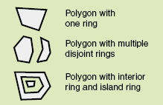
Polygon对象
Polygon(多边形)对象是一个有序环对象的集合，这些环可以是一个或者多个。多边形对象通常可以用于描述具有面积的多边形离散矢量对象。

Slide 14
Geometry
Curve
PolyCurve
Polygon
Is composed of Rings
Rings
Are composed of Segments
Segments
Segments can be of 4 different Types
Line
CircularArc
EllipticArc
BezierCurve
Points are used to build Segments or Polygon
Points
图4-34 Polygon及相关对象结构图

Slide 15
MultiPatch
MultiPatches describe 3D geometries that can have multiple, textured surfaces. They can also store vertex normals（顶点法线）, vertex ids, vertex measures and several part-level attributes.
You can create MultiPatches by importing data from a variety of different file formats (3D Studio Max .3ds files, OpenFlight .flt files, Sketchup .skp files, VRML .wrl files).

Slide 16
You can also create them programmatically in several different ways.
  MultiPatches without textures, normals, or part attributes can be defined in a manner similar to building a polygon: create the parts, create a MultiPatch, then use the latter’s IGeometryCollection interface to add the parts.
  Creating a MultiPatch with textures, normals or part attributes requires the use of the GeneralMultiPatchCreator helper object (requires a 3D Analyst license). You can obtain information on normals and materials from an existing MultiPatch by using its IGeneralMultiPatchInfo interface.

Slide 17
MultiPatches support the IRelationalOperator3D interface (New in 9.3), which contains the Disjoint3D method, and the IProximityOperator3D interface, which has methods for reporting the nearest distance from a query geometry to the MultiPatch and the nearest point on the MultiPatch from a query geometry.
  These interfaces treat MultiPatches as a collection of surfaces with no interior, so if you have a MultiPatch in the shape of a cube, and a point apparently inside that cube, the point will be classified as disjoint because it is not intersecting any of the cube's sides.

Slide 18
MultiPatches contain multiple parts: TriangleStrips, TriangleFans, Triangles, and rings. Each part in a MultiPatch has several additional properties:
  Type (TriangleStrip, TriangleFan, Triangle, Outer Ring, etc)
  Priority — used to control the drawing order of overlapping parts
  An index into the array of materials
MultiPatches can contain materials (specifying color, texture, and transparency information) and texture coordinates that specify the placement of textures on each part.
  ArcScene provides style galleries containing MultiPatch models for 3D buildings (industrial and residential), trees, vehicles, street ‘furniture’ and other thematic categories.

Slide 19
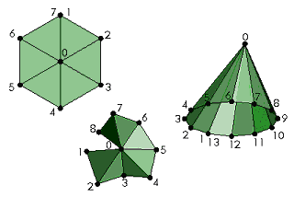
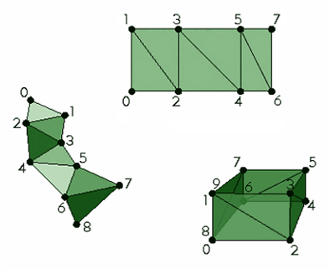
Triangle Strips （条、带）
Triangle Fans（扇）

Slide 20
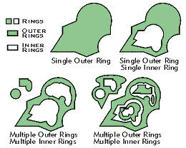
Rings as used in MultiPatches

Slide 21
4.2 使用几何对象
  Working with the geometry environment
  Create a multipoint
  Create a polyline
  Create a polygon
  Creating a union of several polygons
  Modify a specific vertex of a polyline
  Modify a specific segment of a polyline
  Create a multipatch
  IGeometryBag vs. IGeometryCollection
  Simplifying a geometry

Slide 22
4.2.1 Working with the geometry environment
The GeometryEnvironment object is a singleton object（单实例对象）, so calling new several times does not create a new object each time. Instead, it returns a reference to the existing GeometryEnvironment.
GeometryEnvironment provides a way of creating geometries from different inputs and setting or getting global variables for controlling the behavior of geometry methods. It also provides Java and .NET friendly versions of methods originally defined on other geometry objects (see the IGeometryBridge and IGeometryBridge2 interfaces).

Slide 23
IGeometryBridge and IGeometryBridge2 act as a connection to allow methods to be accessed in all supported languages. Both are implemented by GeometryEnvironmentClass. This implementation circumvents（回避， 绕过） limitations placed on Component Object Model (COM) objects in the Java and .NET environments.
In Java and .NET, it is not possible to directly call certain methods on the original interfaces, since the original interfaces were implemented using C-style arrays. Java and the .NET Framework languages do not support C-style arrays. Only safe arrays are permissible in these languages.

Slide 24
Interfaces and methods | IGeometryBridge or IGeometryBridge2
IPointCollection.AddPoints | AddPoints
IPointCollection.QueryPoints | QueryPoints
IPointCollection.InsertPoints | InsertPoints
IPointCollection2.GetPoints | GetPoints
IPointCollection.ReplacePoints | ReplacePoints
IPointCollection.SetPoints | SetPoints
IPointCollection4.QueryWKSPointZs | QueryWKSPointZs
IPointCollection4.InsertWKSPointZs | InsertWKSPointZs
IPointCollection4.AddWKSPointZs | AddWKSPointZs
IPointCollection4.AddWKSPoints* | AddWKSPoints
IPointCollection4.InsertWKSPoints* | InsertWKSPoints
IPointCollection4.QueryWKSPoints* | QueryWKSPoints
IPointCollection4.SetWKSPoints* | SetWKSPoints
IPolycurve2.SplitAtDistances | SplitAtDistances
Interfaces and methods | IGeometryBridge or IGeometryBridge2
ISegmentCollection.AddSegments | AddSegments
ISegmentCollection.InsertSegments | InsertSegments
ISegmentCollection.QuerySegments | QuerySegments
ISegmentCollection.ReplaceSegments | ReplaceSegments
ISegmentCollection.SetSegments | SetSegments
ITopologicalOperator2.ConstructBuffers | ConstructBuffers
IMultipatch.QueryBeginningRings | QueryBeginningRings
IMultipatch.QueryFollowingRings | QueryFollowingRings
IGeometryCollection.AddGeometries | AddGeometries
IGeometryCollection.InsertGeometries | InsertGeometries
IGeometryCollection.QueryGeometries | QueryGeometries
IGeometryCollection.SetGeometries | SetGeometries
ISegment.Densify | Densify
ISegment.SplitDivideLength | SplitDivideLength

Slide 25
  IGeometryBridge2 pGeomBridge = new GeometryEnvironmentClass();
  IPointCollection4 pPointCollection = new MultipointClass();
  IPoint[] pPoints = new IPoint[3];
  for (int i = 0; i < 3; i++)
  {
  pPoints[i] = new PointClass();
  pPoints[i].PutCoords(i, 2 * i);
  }
  pGeomBridge.AddPoints(pPointCollection, ref pPoints);

Slide 26
4.2.2 Create a multipoint
  Building a multipoint using points
  Creating a multipoint using existing geometries
  Creating a multipoint from the vertices of a polyline
  Creating a multipoint using the ConstructIntersectionEx method

Slide 27
Building a multipoint using points
public void CreateMultipointByWKSPoints()
  { int length = 10; WKSPoint[] pointArray = new WKSPoint[length];
  for (int i = 0; i < length; i++)
  {
  pointArray[i].X = i * 10;
  pointArray[i].Y = i * 10; }
  IPointCollection4 pointCollection = new MultipointClass();
  //add points to pointCollection
  IGeometryBridge2 geometryBridge = new GeometryEnvironmentClass();
  geometryBridge.AddWKSPoints(pointCollection, ref pointArray);
  }
  WKSPoint Structure：public WKSPoint { double X, double Y }

Slide 28
Creating a multipoint using existing geometries
public void CreateMultipointFromExistingGeometry(IPolyline pPoly)
  {
  ITopologicalOperator2 pTopoOp2 = pPoly as ITopologicalOperator2;
  pTopoOp2.IsKnownSimple_2 = false;
  pTopoOp2.Simplify();
  IPolygon pBufferedPoly = pTopoOp2.Buffer(5) as IPolygon;
  IPointCollection pPointCollPoly = pBufferedPoly as IPointCollection;
  IGeometry pMultipoint = new MultipointClass();
  pMultipoint.SpatialReference = pPoly.SpatialReference;
  IPointCollection pPointCollMultipoint = pMultipoint as IPointCollection;
  pPointCollMultipoint.AddPointCollection(pPointCollPoly);
  }

Slide 29
Creating a multipoint from the vertices of a polyline
private void TransformPoint (IPolyline polyline)
{ IPointCollection polylinePoints = polyline as IPointCollection;
IGeometry multipoint = new MultipointClass();
multipoint.SpatialReference = polyline.SpatialReference;
IPointCollection multipointPoints = multipoint as IPointCollection;
multipointPoints.AddPointCollection(polylinePoints);
ITransform2D transformee = multipoint as ITransform2D;
IAffineTransformation2D affineTransformation = new AffineTransformation2DClass();
affineTransformation.Move(5, 0);
transformee.Transform(esriTransformDirection.esriTransformForward, affineTransformation);
affineTransformation.Move(0, 5);
transformee.Transform(esriTransformDirection.esriTransformForward, affineTransformation);
}

Slide 30
Creating a multipoint using the ConstructIntersectionEx method
private void ConstructIntersectionEx1( ILine line0, ILine line1, String title)
{ IConstructMultipoint constructMultipoint = new MultipointClass();
double param0; double param1; int bits;
constructMultipoint.ConstructIntersectionEx (line0 as ISegment,
esriSegmentExtension.esriExtendEmbedded, line1 as ISegment,
esriSegmentExtension.esriExtendEmbedded, out param0, out param1, out bits);
……………
}
public void ConstructIntersectionEx
( ISegment segment1, esriSegmentExtension extension1,
ISegment segment2, esriSegmentExtension extension2,
ref double params1, ref double params2, ref int tangentBits);

Slide 31
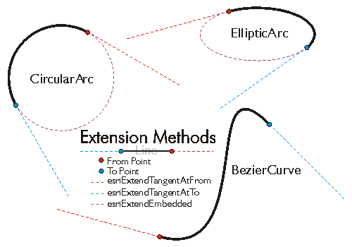
esriSegmentExtension
Constant | Value
esriNoExtension | 0
esriExtendTangentAtFrom | 1
esriExtendEmbeddedAtFrom | 2
esriExtendTangentAtTo | 4
esriExtendEmbeddedAtTo | 8
esriExtendTangents | 5
esriExtendEmbedded | 10
esriExtendAtFrom | 3
esriExtendAtTo | 12

Slide 32
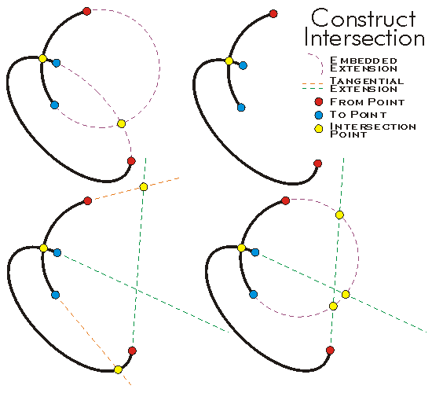


Slide 33
4.2.3 Create a polyline
  Building a polyline using points
  Building a polyline using segments
  Creating a polyline using existing geometries
  Creating a multipart polyline

Slide 34
Building a polyline using points
public void CreatePolylineByPoints()
  { int length = 10;
  WKSPoint[] pointArray = new WKSPoint[length];
  for (int i = 0; i < length; i++)
  {
  pointArray[i].X = i * 10; pointArray[i].Y = i * 10;
  }
  IPointCollection4 pointCollection = new PolylineClass();
  IGeometryBridge2 geometryBridge = new GeometryEnvironmentClass();
  geometryBridge.SetWKSPoints(pointCollection, ref pointArray);
  }

Slide 35
Building a polyline using segments
public void CreatePolylineBySegments()
  { IPolyline pSegPoly = new PolylineClass();
  ICircularArc cArc = new CircularArcClass();
  IBezierCurve bCur = new BezierCurveClass();
  ILine line = new LineClass();
  ISegmentCollection path1 = new PathClass();
  ISegmentCollection path2 = new PathClass();
  object obj=Type.Missing;
  path1.AddSegment(cArc as ISegment,ref obj,ref obj);
  path2.AddSegment(bCur as ISegment, ref obj, ref obj);
  path2.AddSegment(line as ISegment, ref obj, ref obj);
  IGeometryCollection pGeoColl = pSegPoly as IGeometryCollection;
  pGeoColl.AddGeometry(path1 as IGeometry ,ref obj,ref obj);
  pGeoColl.AddGeometry(path2 as IGeometry, ref obj, ref obj);

Slide 36
  IPoint pPnt = new PointClass();
  pPnt.X = -10;
  pPnt.Y = 0;
  cArc.PutCoordsByAngle(pPnt, 0, 3.14159265358979, 10.0);
  IPoint[] pntArray = new IPoint[4];
  for (int i = 0; i <= 4; i++) pntArray[i] = new PointClass();
  pntArray[0].X = 10; pntArray[0].Y = 0;
  pntArray[1].X = 10; pntArray[1].Y = 10;
  pntArray[2].X = 20; pntArray[2].Y = 10;
  pntArray[3].X = 20; pntArray[3].Y = 0;
  bCur.PutCoords(4,ref pntArray[0]);
  line.FromPoint.PutCoords(20, 0);
  line.ToPoint.PutCoords(30, 0);
  pGeoColl.GeometriesChanged();
  }

Slide 37
Creating a polyline using existing geometries
public void CreatePolylineFromExistingGeometries ( IPolygon pPolygon1, IPolygon pPolygon2)
  { //Build a new polyline by intersecting two existing polygons.
  ITopologicalOperator2 pTopoOp2 = pPolygon1 as ITopologicalOperator2;
  pTopoOp2.IsKnownSimple_2 = false;
  pTopoOp2.Simplify();
  IPolyline pPoly = pTopoOp2.Intersect(pPolygon2, esriGeometryDimension.esriGeometry1Dimension) as IPolyline;
  }

Slide 38
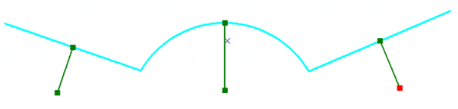
Creating a multipart polyline
使用已有的线对象创建一个多段线对象.
  要求：创建的多段线对象的每一线段与已有线对象垂直，且位于已有线段的中点处，长度为已有线段的1/3.

Slide 39
public IPolyline ConstructMultiPartPolyline( IPolyline inputPolyline)
  { IGeometry outGeometry = new PolylineClass();
  outGeometry.SpatialReference = inputPolyline.SpatialReference; IGeometryCollection geometryCollection = outGeometry as IGeometryCollection;
  ISegmentCollection segmentCollection = inputPolyline as ISegmentCollection;
  IEnumSegment segments = segmentCollection.EnumSegments;
  ISegment currentSegment;
  int partIndex = 0; int segmentIndex = 0;
  segments.Next( out currentSegment, ref partIndex, ref segmentIndex);

Slide 40
  while (currentSegment != null)
  { ILine normal = new LineClass();
  currentSegment.QueryNormal(esriSegmentExtension.esriNoExtension, 0.5, true, currentSegment.Length / 3, normal);
  ISegmentCollection newPath = new PathClass();
  object missing = Type.Missing;
  newPath.AddSegment(normal as ISegment, ref missing, ref missing);
  geometryCollection.AddGeometry(newPath as IGeometry, ref missing, ref missing);
  segments.Next(out currentSegment, ref partIndex, ref segmentIndex);
  }
  return geometryCollection as IPolyline;
  }
public void QueryNormal (
esriSegmentExtension extension,
double DistanceAlongCurve,
bool asRatio,
Double Length,
ILine normal );

Slide 41
4.2.4 Create a polygon
  Building a polygon using points
  Building a polygon using segments
  Creating a polygon using existing geometries
  Creating a union of several polygons

Slide 42
Building a polygon using points
public void CreatePolygonByPoints()
  { int length = 10;
  WKSPoint[] pointArray = new WKSPoint[length];
  for (int i = 0; i < length; i++)
  {
  pointArray[i].X = i * 10; pointArray[i].Y = i * 10;
  }
  IGeometryBridge2 pGeoBrg = new GeometryEnvironmentClass();
  IPointCollection4 pPointColl = new PolygonClass();
  //add points to pointCollection
  pGeoBrg.SetWKSPoints(pPointColl, ref pointArray);
  }

Slide 43
Building a polygon using segments
public void CreatePolygonBySegments()
  {
  IPolygon pSegPoly = new PolygonClass();
  ICircularArc cArc = new CircularArcClass();
  IBezierCurve bCur = new BezierCurveClass();
  ISegmentCollection ring1 = new RingClass();
  ISegmentCollection ring2 = new RingClass();
  object obj = Type.Missing;
  ring1.AddSegment(cArc as ISegment, ref obj, ref obj);
  ring2.AddSegment(bCur as ISegment, ref obj, ref obj);
  IGeometryCollection pGeoColl = pSegPoly as IGeometryCollection;
  pGeoColl.AddGeometry(ring1 as IGeometry, ref obj, ref obj);
  pGeoColl.AddGeometry(ring2 as IGeometry, ref obj, ref obj);

Slide 44
  IPoint pPnt = new PointClass();
  pPnt.X = -10; pPnt.Y = 0;
  cArc.PutCoordsByAngle(pPnt, 0, 2 * 3.14159265358979, 10.0);
  IPoint[] pntArray = new IPoint[4];
  for (int i = 0; i <= 4; i++) pntArray[i] = new PointClass();
  pntArray[0].X = 10; pntArray[0].Y = 0;
  pntArray[1].X = 10; pntArray[1].Y = 10;
  pntArray[2].X = 20; pntArray[2].Y = 10;
  pntArray[3].X = 20; pntArray[3].Y = 0;
  bCur.PutCoords(4, ref pntArray[0]);
  pGeoColl.GeometriesChanged();
  }

Slide 45
Creating a polygon using existing geometries
public void CreatePolygonFromExistingGeometries( IPolygon pPolygon1, IPolygon pPolygon2)
  {
  ITopologicalOperator2 pTopoOp2 = pPolygon1 as ITopologicalOperator2;
  pTopoOp2.IsKnownSimple_2 = false;
  pTopoOp2.Simplify();
  IPolygon pPoly = pTopoOp2.Union(pPolygon2) as IPolygon;
  }

Slide 46
Creating a union of several polygons
private IPolygon GeometryBag_Example(IFeatureClass featureClass)
  {
  if (featureClass == null) return null;
  IGeoDataset geoDataset = featureClass as IGeoDataset;
  IGeometry geometryBag = new GeometryBagClass();
  geometryBag.SpatialReference = geoDataset.SpatialReference;
  IFeatureCursor featureCursor = featureClass.Search(null, false);
  IGeometryCollection geometryCollection = geometryBag as IGeometryCollection;
  IFeature currentFeature = featureCursor.NextFeature();

Slide 47
  while (currentFeature != null)
  {
  object missing = Type.Missing;
  geometryCollection.AddGeometry(currentFeature.Shape, ref missing, ref missing);
  currentFeature = featureCursor.NextFeature();
  }
  ITopologicalOperator unionedPolygon = new PolygonClass();
  unionedPolygon.ConstructUnion(geometryBag as IEnumGeometry);
  return unionedPolygon as IPolygon;
  }

Slide 48
4.2.5 Modify a specific vertex of a polyline
The following are the steps to modify a vertex of a polyline:
  Cast the IGeometryCollection for IPolyline.
  Cast the polyline for IHitTest and use the HitTest method (esriGeometryPartVertex option).
  Use the geometry property with the part index returned by the HitTest to get the path containing the point to modify.
  Cast the path for IPointCollection.
  Use the point property with the vertex (segment) index returned by the HitTest (get a copy of the point).
  Modify the point using any methods.
  Update the point using UpdatePoint with the vertex index from HitTest.

Slide 49
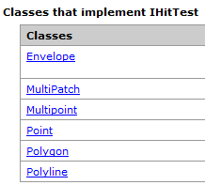
public bool IHitTest .HitTest (
  IPoint QueryPoint,
  double searchRadius,
  esriGeometryHitPartType geometryPart,
  IPoint hitPoint,
  ref double hitDistance,
  ref int hitPartIndex,
  ref int hitSegmentIndex,
  ref bool bRightSide );

Slide 50
The segment index returned has different meanings depending on the esriGeometryHitPartType used .
  EsriGeometryPartVertex: returns a vertex index
  EsriGeometryPartBoundary, esriGeometryPartMidpoint and esriGeometryPartEndpoint: return a segment index
  EsriGeometryPartCentroid: Always returns 0 for the part index and the segment index.
brightside: Indicates if the input point is on the right side of the input geometry

Slide 51
public IPointCollection4 modify1VertexOfAPolyline( IGeometryCollection mPolyline, Double searchRadius, Double offsetX, Double offsetY)
  { IPoint queryPoint = m_activePoint; //如鼠标点击位置
  IPoint hitPoint = new PointClass();
  Double hitDistance = 0; Int32 hitPartIndex = 0;
  Int32 hitSegmentIndex = 0;
  Boolean rightSide = false;
  IHitTest hitTest = (IHitTest)mPolyline;
  Boolean foundGeometry = hitTest.HitTest (queryPoint, searchRadius, esriGeometryHitPartType.esriGeometryPartVertex, hitPoint, ref hitDistance, ref hitPartIndex, ref hitSegmentIndex, ref rightSide);

Slide 52
  if (foundGeometry == true)
  {
  IGeometry geometry = mPolyline.get_Geometry(hitPartIndex);
  IPointCollection4 pointCollection = (IPointCollection4) geometry;
  IPoint transformPoint = pointCollection.get_Point(hitSegmentIndex);
  ITransform2D transform2D = (ITransform2D)transformPoint;
  transform2D.Move(offsetX, offsetY);
  pointCollection.UpdatePoint(hitSegmentIndex, transformPoint );
  return pointCollection;
  }
  return null;
  }

Slide 53
4.2.6 Modify a specific segment of a polyline
The following are the steps to modify a polyline segment:
  Cast the IGeometryCollection for the polyline.
  Cast the polyline for IHitTest and use the HitTest method (esriGeometryPartBoundary option).
  Use the geometry property with the part index returned by the HitTest to get the path containing the point to modify.
  Cast the path for ISegmentCollection.
  Use the segment property with the segment index returned by the HitTest (get a reference to the segment).
  Modify the segment.

Slide 54
public ISegmentCollection Modify1Segment (IGeometryCollection mPolyline, Double searchRadius, Double offsetX, Double offsetY)
  {
  IPoint queryPoint = m_activePoint;
  IPoint hitPoint = new PointClass();
  Double hitDistance = 0; Int32 hitPartIndex = 0;
  Int32 hitSegmentIndex = 0; Boolean rightSide = false;
  IHitTest hitTest = (IHitTest)mPolyline;
  Boolean foundGeometry = hitTest.HitTest (queryPoint, searchRadius, esriGeometryHitPartType. esriGeometryPartBoundary , hitPoint, ref hitDistance, ref hitPartIndex, ref hitSegmentIndex, ref rightSide);

Slide 55
  if (foundGeometry == true)
  { IGeometry geometry = mPolyline.get_Geometry(hitPartIndex);
  ISegmentCollection segmentCollection =
  (ISegmentCollection)geometry;
  ISegment segment = segmentCollection.get_Segment(hitSegmentIndex);
  ITransform2D transform2D = (ITransform2D)segment;
  transform2D.Move(offsetX, offsetY);
  segmentCollection.SegmentsChanged();
  return segmentCollection;
  }
  return null;
  }

Slide 56
4.2.7 How to add point IDs to a polyline
public void AddPointIDs (IFeatureClass featureClass)
  { IFeatureCursor featureCursor = featureClass.Search(null, true);
  IFeature currentFeature = featureCursor.NextFeature();
  while (currentFeature != null)
  { IPointIDAware pointIDAware = currentFeature.Shape as IPointIDAware;
  pointIDAware.PointIDAware = true;
  ISegmentCollection segmentCollection = pointIDAware as ISegmentCollection;
  IEnumSegment segmentEnumeration = segmentCollection.EnumSegments;
  ISegment currentSegment; int partIndex = 0; int segmentIndex = 0;
  segmentEnumeration.Next(out currentSegment, ref partIndex, ref segmentIndex);

Slide 57
  while (currentSegment != null)
  {
  ISegmentID segmentID = currentSegment as ISegmentID;
  segmentID.SetIDs(segmentIndex, segmentIndex + 1);
  segmentEnumeration.Next(out currentSegment, ref partIndex, ref
  segmentIndex);
  }
  currentFeature.Shape = pointIDAware as IGeometry;
  currentFeature.Store();
  currentFeature = featureCursor.NextFeature();
  }
  }

Slide 58
4.2.8 Create a multipatch
  Creating a multipatch using a series of triangles
  Sample: 3D multipatch examples

Slide 59
4.2.9 IGeometryBag vs. IGeometryCollection
GeometryBag是不同类型的几何对象(支持IGeometry)的集合。某一特定接口中的操作要作用于GeometryBag上， 要求GeometryBags中的所有几何对象必须支持该接口，否则会出错。（如：要对GeometryBag中的所有元素执行ITopologicalOperator中的Buffer操作，则GeometryBag中只能放入支持ITopologicalOperator 的几何对象。）
当往GeometryBag添加新的几何对象时，新的几何对象将获得GeometryBag 的空间参考。如果GeometryBag 的空间参考为空，则新的几何对象将丢失空间参考。

Slide 60
Interfaces
IConstructGeometryCollection
IEnumGeometry
IGeometry
IGeometry2
IGeometry3
IGeometry4
IGeometry5
IGeometryBag
IGeometryCollection
IRelationalOperator
IRelationalOperator2
ISpatialIndex
ITopologicalOperator
ITransform2D
GeometryBag实现的主要接口
IGeometryBag继承自IGeometry，并增加了一个属性：
  public bool LosslessExport {get;}

Slide 61
IGeometryCollection 接口提供了访问多部分几何对象(Multipoint, Polyline, Polygon, MultiPatch, 及GeometryBag)中某一部分的属性、方法。
  对于Multipoints, Triangles, TriangleFans和TriangleStrips, 其几何对象的某一部分为Point.
  对于Polylines,其几何对象的某一部分为Path.
  对于Polygons,其几何对象的某一部分为Ring.
  对于MultiPatches,其几何对象的某一部分为Triangle, TriangleFan, TriangleStrip, 或Ring.
  对于GeometryBags,其几何对象的某一部分为任一IGeometry 对象。

Slide 62
  IGeometryCollection 可用于访问、操作、添加、插入、去除和设置复合几何对象的某一特定组成部分。
  如果使用的开发语言不支持C语言样式的数组，则需要使用IGeometryBridge/ IGeometryBridge2.
Interfaces and methods | IGeometryBridge or IGeometryBridge2
IGeometryCollection.AddGeometries | AddGeometries
IGeometryCollection.InsertGeometries | InsertGeometries
IGeometryCollection.QueryGeometries | QueryGeometries
IGeometryCollection.SetGeometries | SetGeometries

Slide 63
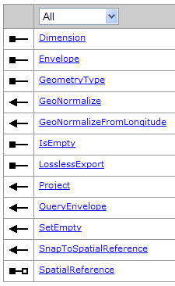
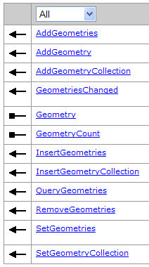
IGeometryBag
IGeometryCollection

Slide 64
4.2.10 Simplifying a geometry
一个几何对象的简化( Simplify )处理会改变该几何对象，使得其定义拓扑上与其几何类型相一致(如线不能自相交，多边形不能自重叠)。
点的简化
  点的简化不作任何处理，点对其坐标值没有任何约束。
多点的简化
  对于多点，简化处理将x-, y-, z-, 及 m坐标捕捉到其空间参考系的格网点上，并删除完全相同的点。两个完全相同的点，不仅其x,y相同(捕捉后)，而且其感知的属性也完全相同，如两个点都对Z值感知(z-aware)，它们的Z 坐标也必须相同。

Slide 65
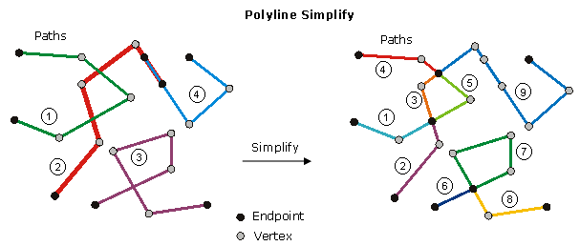
多段线的简化
  多段线的简化有2种类型：平面的(planar )和非平面的(nonplanar )。
    缺省情况下，对m值不感知的多段线使用平面的简化方式，即所有重叠的线段简化为单个线段，且在交点处分割线段，为相连的线段序列创建输出路径。输入线段的方向尽可能保留，但路径内部的线段必要的时候需重定向。
    对m值感知的多段线使用非平面的简化方式，即重叠的、自相交的线段保留，但长度为0的线段删除；线段的定向需要调整，使得线段I的终点与线段I+1的起点一致；不相连的线段将创建新的路径；共享公共端点的现有的路径将合并。

Slide 66
多边形的简化
  多边形的简化首先识别多边形的内部和外部，然后修改多边形的结构使其与上述识别结果一致。识别多边形内部和外部的默认方法如下：
    删除所有的悬挂线段序列；
    识别最大的合法的环，并将它们添加到多边形的输出版本中，然后从工作版本中删除。
    重复。如果这种方法删除过多的线段，则可以考虑使用IPolygon4.SimplifyEx() 方法，并将XOR 参数设置为true 进行简化处理。简化处理结果中，不能存在重叠的环，也不能存在自相交的现象；并且，对于任意一个点，能够明确地确定它在多边形的内部、外部或边界上。

Slide 67
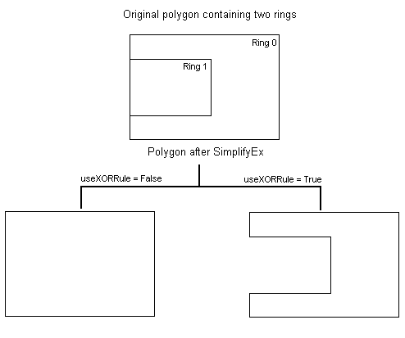
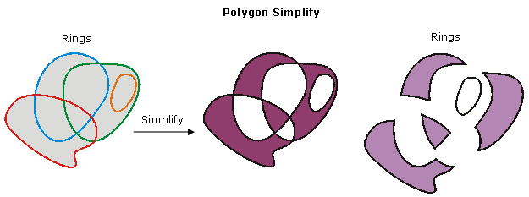

Slide 68
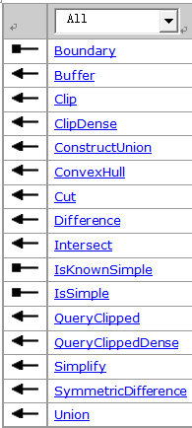
What Simplify considers
  简化处理开始之前首先检测ITopologicalOperator.IsKnownSimple属性，如果该属性为true，简化操作将中止；如果该属性为false ，简化操作将检测几何对象的一致性，需要的时候并更新几何对象。
  ITopologicalOperator中的方法仅适用于高级几何对象 ，如point, multipoint, polyline, 及 polygon. 几何构件(line, circular arc, elliptic arc, Bézier curve, paths, or rings )要使用这些方法，必须将它们包装成高级几何对象类型。

Slide 69
4.3 空间参考
空间参考（Spatial Reference）是GIS数据的骨骼框架，能够将空间数据定位到相应的位置，为地图中的每一点提供准确的坐标。
Geodatabase中新建一个要素数据集或一个单独的要素类都必须设置它们的空间参考。
空间参考包括以下属性：
  坐标系(地理坐标系、投影坐标系、垂直坐标系)
  分辨率与空间域
  容差

Slide 70
GEOGCS
  ["GCS_Xian_1980",
  DATUM["D_Xian_1980",SPHEROID["Xian_1980",6378140.0,298.257] ],
  PRIMEM["Greenwich",0.0],
  UNIT["Degree",0.0174532925199433]]

Slide 71
PROJCS
  ["Xian_1980_3_Degree_GK_Zone_38",
  GEOGCS["GCS_Xian_1980",DATUM["D_Xian_1980",SPHEROID["Xian_1980",6378140.0,298.257]],PRIMEM["Greenwich",0.0],UNIT["Degree",0.0174532925199433]],
  PROJECTION["Gauss_Kruger"],
  PARAMETER["False_Easting",38500000.0],
  PARAMETER["False_Northing",0.0],
  PARAMETER["Central_Meridian",114.0],
  PARAMETER["Scale_Factor",1.0],
  PARAMETER["Latitude_Of_Origin",0.0],
  UNIT["Meter",1.0]]

Slide 72
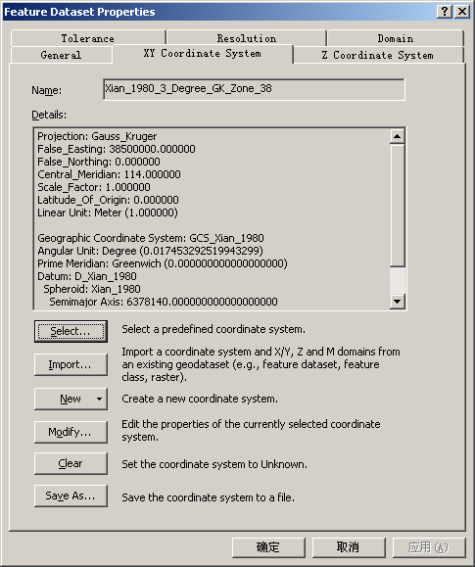

Slide 73
Use the SpatialReferenceEnvironment
ArcObjects包含大量的预定义的空间参考系以及空间参考系的构建块(building blocks) .
  每个预定义的对象由一个工厂代码识别(a factory code)。工厂代码由esriSR 开头的枚举集合定义，一般使用枚举宏(enumeration macro)而不是整数值来生成预定义的对象。
esriSRGeoCS_Beijing1954 | 4214 | Beijing 1954.
esriSRGeoCS_Xian1980 | 4610 | Xian 1980.
esriSRProjCS_Beijing1954GK_23 | 21423 | Beijing 1954 GK Zone 23.
esriSRProjCS_Beijing1954GK_13N | 21473 | Beijing 1954 GK Zone 13N.
esriSRProjCS_Beijing1954_3_Degree_GK_Zone_38 | 2414 | Beijing 1954 3 Degree GK Zone 38.
esriSRProjCS_Xian1980_3_Degree_GK_Zone_38 | 2362 | Xian 1980 3 Degree GK Zone 38.

Slide 74
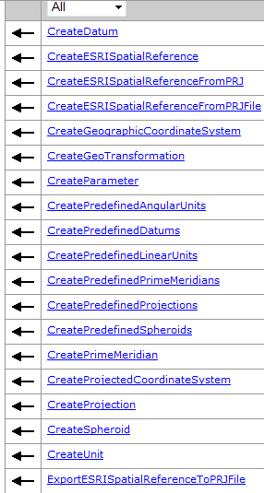
ISpatialReferenceFactory接口提供的方法使用FactoryCode 来生成预定义的空间参考对象，这个接口提供了三种类型的方法：
  返回单个对象的方法
  返回同类对象集合的方法
  基于PRJ 文件或PRJ字符串表达来导入/导出空间参考对象的方法

Slide 75
private void PrintPreDefinedProjections()
  { ISpatialReferenceFactory spatialReferenceFactory = new SpatialReferenceEnvironmentClass();
  ISet projectionSet = spatialReferenceFactory.CreatePredefinedProjections(); MessageBox.Show("Number of predefined Projections = " + projectionSet.Count);
  projectionSet.Reset();
  for(int i = 0; i < projectionSet.Count; i++)
  { IProjection projection = projectionSet.Next() as IProjection; MessageBox.Show(projection.Name); }
  }

Slide 76
private void CreateGeographicCoordinateSystem()
  { // SpatialReferenceEnvironment is a singleton object and needs to use the Activator class.
  Type t = Type.GetTypeFromProgID("esriGeometry.SpatialReferenceEnvironment");
  System.Object obj = Activator.CreateInstance(t);
  ISpatialReferenceFactory srFact = obj as ISpatialReferenceFactory;
  // Use the enumeration to create an instance of the predefined object.
  IGeographicCoordinateSystem geographicCS = srFact.CreateGeographicCoordinateSystem((int)esriSRGeoCSType.esriSRGeoCS_NAD1983);
  }

Slide 77
单实例对象的创建与释放
Runtime callable wrappers and the System._COMObject type
  在.NET中，每个类、接口、枚举类型等通过其类型进行描述。Type 类（.NET 框架中的类）包含一个数据类型的数据成员及函数成员的有关信息。当在.NET中通过interop创建COM对象时，你获得了该对象的引用（该对象被包装在RCW 中） ， 在.NET应用程序内部， RCW拥有对该COM对象的引用。

Slide 78
代码1：
  ISimpleMarkerSymbol sym = new SimpleMarkerSymbolClass();
  Debug.WriteLine(sym.GetType().FullName);
  运行以上代码时，sym 的类型是SimpleMarkerSymbolClass， sym拥有了SimpleMarkerSymbolClass的ISimpleMarkerSymbol 的引用。
代码2：
  ISimpleMarkerSymbol sym = rend.Symbol as ISimpleMarkerSymbol;
  Debug.WriteLine(sym.GetType().FullName);
  上述代码中，sym通过另一个对象rend(ISimpleRenderer)的属性获得对一个RCW(SimpleMarkerSymbol)的引用.

Slide 79
分析比较：
  代码1中，通过new 关键字创建了一个SimpleMarkerSymbolClass 类型的符号sym。当代码编译的时候，编译器使用 Reflection 机制能够发现变量的确切类型，且将该类型的元数据保存到编译后的代码中。当代码运行的时候，运行时拥有变量类型的所有信息。
  代码2中，通过ISimpleRenderer的Symbol属性设置了sym变量的值。当代码编译的时候，编译器能够发现的元数据只有Symbol属性返回的对ISymbol的引用，其对象的确切类型不能被发现。 尽管可以使用接口查询获得sym 变量的ISimpleMarkerSymbol ，但代码运行的时候，运行时没有所需的元数据来发现变量的确切类型。在这种情况下，当访问Symbol属性时，.NET 运行时将对COM 对象的引用包装在通用的RCW: System._ComObject中。 System._ComObject是.NET 框架内部的类，用于引用任何类型的COM对象，其目的是扮演一个未知类型的COM对象的RCW。

Slide 80
单实例对象仅支持对象的一个实例。当使用new 关键字实例化一个单实例的COM对象(singleton )时，如果之前该COM类已经实例化了，你将获得对一个已经存在的对象的引用，而不是又产生一个实例对象。
在ArcObjects中，单实例对象需要通过Activator类实例化， 并需要通过ComReleaser 类明确释放(explicit release )。
  Type t = Type.GetTypeFromProgID("esriDisplay.ServerStyleGallery");
  System.Object obj = Activator.CreateInstance(t);
  IStyleGallery sg = obj as IStyleGallery;

Slide 81
private IProjectedCoordinateSystem LoadProjectedCoordinateSystem()
  { ISpatialReferenceFactory spatialReferenceFactory = new SpatialReferenceEnvironmentClass();
  IProjectedCoordinateSystem projectedCoordinateSystem = spatialReferenceFactory.CreateESRISpatialReferenceFromPRJFile("C:\\Program Files\\ArcGIS\\Coordinate Systems\\Projected Coordinate Systems\\World\\Mollweide (world).prj") as IProjectedCoordinateSystem;
  return projectedCoordinateSystem;
  }

Slide 82
private void CreateProjectedCoordinateSystem()
  { // SpatialReferenceEnvironment is a singleton object and needs to use the Activator class.
  Type t = Type.GetTypeFromProgID("esriGeometry.SpatialReferenceEnvironment");
  System.Object obj = Activator.CreateInstance(t);
  ISpatialReferenceFactory srFact = obj as ISpatialReferenceFactory;
  // Use the enumeration to create an instance of the predefined object.
  IProjectedCoordinateSystem projectedCS = srFact.CreateProjectedCoordinateSystem((int)esriSRProjCSType.esriSRProjCS_NAD1983UTM_11N);
  }

Slide 83
Creating a predefined vertical coordinate system
private static void GetVCSList()
  {ISpatialReferenceFactory3 srFact3 = new SpatialReferenceEnvironmentClass() as ISpatialReferenceFactory3;
  ISet vcsSet = srFact3.CreatePredefinedVerticalCoordinateSystems();
  vcsSet.Reset();
  IVerticalCoordinateSystem vcs;
  for (int i = 0; i < vcsSet.Count; i++)
  { vcs = vcsSet.Next() as IVerticalCoordinateSystem;
  Console.WriteLine("VCS Name: {0} (Code: {1})", vcs.Name, vcs.FactoryCode);
  }
  }

Slide 84
private void CreateVerticalReferenceSystem()
  {
  ISpatialReferenceFactory3 spatialReferenceFactory3 = new SpatialReferenceEnvironmentClass();
  IVerticalCoordinateSystem verticalCoordinateSystem = spatialReferenceFactory3.CreateVerticalCoordinateSystem((int) esriSRVerticalCSType.esriSRVertCS_Alicante);
  }

Slide 85
Creating a custom geographic coordinate system
地理坐标系包含坐标系的名称、角度单位、大地基准(datum，包含椭球体)及本初子午线(prime meridian)。通过IGeographicCoordinateSystem2接口提供的属性、方法可以访问、创建地理坐标系的相关对象。
尽管绝大多数开发人员无须创建自定义的地理坐标系，但IGeographicCoordinateSystemEdit 还是提供了Define() 及DefineEx() 方法.

Slide 86
public void Define (
ref object Name,
ref object Alias,
ref object Abbreviation,
ref object Remarks,
ref object useage,
ref object Datum,
ref object PrimeMeridian,
ref object geographicUnit);
public void DefineEx (
string Name,
string Alias,
string Abbreviation,
string Remarks,
string useage,
IDatum Datum,
IPrimeMeridian PrimeMeridian,
IAngularUnit geographicUnit);

Slide 87
private IGeographicCoordinateSystem CreateGeographicCoordinateSystem()
  { ISpatialReferenceFactory3 spatialReferenceFactory = new SpatialReferenceEnvironmentClass();
  IDatum datum = spatialReferenceFactory.CreateDatum((int)esriSRDatumType.esriSRDatum_OSGB1936);
  IPrimeMeridian primeMeridian = spatialReferenceFactory.CreatePrimeMeridian((int)esriSRPrimeMType.esriSRPrimeM_Greenwich);
  IUnit unit = spatialReferenceFactory.CreateUnit((int)esriSRUnitType.esriSRUnit_Degree);
  IGeographicCoordinateSystemEdit geographicCoordinateSystemEdit = new GeographicCoordinateSystemClass();
  object name = "UserDefined Geographic Coordinate System";
  object alias = "UserDefined GCS";

Slide 88
  object abbreviation = "UserDefined";
  object remarks = "User Defined Geographic Coordinate System based on OSGB1936";
  object usage = "Suitable for the UK";
  object datumObject = datum as object;
  object primeMeridianObject = primeMeridian as object;
  object unitObject = unit as object;
  geographicCoordinateSystemEdit.Define (ref name, ref alias, ref abbreviation, ref remarks, ref usage, ref datumObject, ref primeMeridianObject, ref unitObject);
  IGeographicCoordinateSystem userDefinedGeographicCoordinateSystem = geographicCoordinateSystemEdit as IGeographicCoordinateSystem;
  return userDefinedGeographicCoordinateSystem;
  }

Slide 89
Creating a custom projected coordinate system
投影坐标系的组成部分，如投影(projection)、线性单位、地理坐标系等都是对象，都支持ISpatialReference2 和ISpatialReferenceFactory. 当定义定制的投影坐标系时，可以使用多种esriSR* 枚举集合中预定义的对象。
通过IProjectedCoordinateSystem5接口提供的属性、方法可以访问、创建投影坐标系相关对象。

Slide 90
IProjectedCoordinateSystemEdit 接口中包含了Define(), 用于定义定制的投影坐标系。
public void Define (
ref object Name,
ref object Alias,
ref object Abbreviation,
ref object Remarks,
ref object useage,
ref object gcs,
ref object projectedUnit,
ref object Projection,
ref object parameters);
ISpatialReferenceFactory 接口中的CreateProjectedCoordinateSystem()方法，可以访问几百个预定义的投影坐标系。预定义的投影坐标系包含在esriSRProjCSType, esriSRProjCS2Type, esriSRProjCS3Type, 和esriSRProjCS4Type 枚举类型中。

Slide 91
private IProjectedCoordinateSystem CreateProjectedCoordinateSystem()
  { ISpatialReferenceFactory2 spatialReferenceFactory = new SpatialReferenceEnvironmentClass();
  IProjectionGEN projection = spatialReferenceFactory.CreateProjection( (int) esriSRProjectionType.esriSRProjection_Sinusoidal) as IProjectionGEN;
  IGeographicCoordinateSystem geographicCoordinateSystem = spatialReferenceFactory.CreateGeographicCoordinateSystem((int) esriSRGeoCSType.esriSRGeoCS_WGS1984);
  ILinearUnit unit = spatialReferenceFactory.CreateUnit((int) esriSRUnitType.esriSRUnit_Meter)as ILinearUnit;
  IParameter[] parameters = projection.GetDefaultParameters();
  IProjectedCoordinateSystemEdit projectedCoordinateSystemEdit = new ProjectedCoordinateSystemClass();

Slide 92
  object name = "Newfoundland"; object alias = "NF_LAB";
  object abbreviation = "NF";
  object remarks = "Most Eastern Province in Canada";
  object usage = "When making maps of Newfoundland";
  object geographicCoordinateSystemObject = geographicCoordinateSystem as object;
  object unitObject = unit as object;
  object projectionObject = projection as object;
  object parametersObject = parameters as object; projectedCoordinateSystemEdit.Define( ref name, ref alias, ref abbreviation, ref remarks, ref usage, ref geographicCoordinateSystemObject, ref unitObject, ref projectionObject, ref parametersObject);
  return projectedCoordinateSystemEdit as IProjectedCoordinateSystem;
  }

Slide 93
Creating a custom vertical coordinate system
The ISpatialReferenceFactory3 interface allows you to create the Datum, VerticalDatum, and LinearUnit component parts. These components can also be created using a similar Define method available on their classes.

Slide 94
private IVerticalCoordinateSystem CreateVerticalCoordinateSystem()
  { ISpatialReferenceFactory3 spatialReferenceFactory = new SpatialReferenceEnvironmentClass();
  IVerticalDatum verticalDatum = spatialReferenceFactory.CreateVerticalDatum((int)esriSRVerticalDatumType.esriSRVertDatum_Taranaki);
  IHVDatum hvDatum = verticalDatum as IHVDatum;
  ILinearUnit linearUnit = spatialReferenceFactory.CreateUnit((int)esriSRUnitType.esriSRUnit_Meter) as ILinearUnit;
  IVerticalCoordinateSystemEdit verticalCoordinateSystemEdit = new VerticalCoordinateSystemClass();
  object name = "New VCoordinateSystem";
  object alias = "VCoordinateSystem alias";
  object abbreviation = "abbr";

Slide 95
  object remarks = "Test for options";
  object usage = "New Zealand";
  object hvDatumObject = hvDatum as object;
  object unitObject = linearUnit as object;
  object verticalShift = 40 as object;
  object positiveDirection = -1 as object;
  verticalCoordinateSystemEdit.Define (ref name, ref alias, ref abbreviation, ref remarks, ref usage, ref hvDatumObject, ref unitObject, ref verticalShift, ref positiveDirection);
  IVerticalCoordinateSystem verticalCoordinateSystem = verticalCoordinateSystemEdit as IVerticalCoordinateSystem;
  return verticalCoordinateSystem;
  }

Slide 96
private IVerticalCoordinateSystem CreateEllipsoidBasedVerticalCoordinateSystem()
  { ISpatialReferenceFactory3 spatialReferenceFactory = new SpatialReferenceEnvironmentClass();
  IDatum datum = spatialReferenceFactory.CreateDatum((int)esriSRDatumType.esriSRDatum_WGS1984);
  IHVDatum hvDatum = datum as IHVDatum;
  ILinearUnit linearUnit = spatialReferenceFactory.CreateUnit((int)esriSRUnitType.esriSRUnit_Foot) as ILinearUnit;
  IVerticalCoordinateSystemEdit verticalCoordinateSystemEdit = new VerticalCoordinateSystemClass();
  object name = "WGS84 vcs";
  object alias = "WGS84 ellipsoid";

Slide 97
  object abbreviation = "w84 3d";
  object remarks = "WGS84 ell-based vcs";
  object usage = "everywhere!";
  object hvDatumObject = hvDatum as object;
  object unitObject = linearUnit as object;
  object verticalShift = 0.4839 as object;
  object positiveDirection = -1 as object;
  verticalCoordinateSystemEdit.Define (ref name, ref alias, ref abbreviation, ref remarks, ref usage, ref hvDatumObject, ref unitObject, ref verticalShift, ref positiveDirection);
  IVerticalCoordinateSystem verticalCoordinateSystem = verticalCoordinateSystemEdit as IVerticalCoordinateSystem;
  return verticalCoordinateSystem;
  }

Slide 98
4.4 地理变换（Geotransformation）
地理变换是一种数学运算，它将点的坐标从一个地理坐标系变换到另一个地理坐标系，也可以逆变换。地理变换包含名称、2个地理坐标系（源、目标地理坐标系）、变换的方法或类型、方法所需的任何参数，每一种变换的方法或类型都是一个类。AO提供了以下类型的变换：

Slide 99
  AbridgedMolodenskyTransformation
  CoordinateFrameTransformation
  GeocentricTranslation
  HARNTransformation
  LongitudeRotationTransformation
  MolodenskyBadekasTransformation
  MolodenskyTransformation
  NADCONTransformation
  NTv2Transformation
  PositionVectorTransformation

Slide 100
Geotransformation interfaces
  地理变换类上的接口允许设置变换所需的参数。高精度参考网络 (HARN)、北美基准转换 (NADCON)以及国家地理变换版本2 (NTv2) 是基于网格的地理变换，它们使用磁盘上的文件来计算数据的平移；使用IGridTransformation接口访问 磁盘上的信息，使用IGeoTransformation 接口设置源和目标空间参考。 IGeometry2 中的ProjectEx()方法有一个esriTransformDirection类型的参数 ，当地理变换的方向为源空间参考到目标空间参考时，将该参数设置为esriTransformForward ；当地理变换的方向为反方向时，将该参数设置为esriTransformReverse.

Slide 101
  要访问预定义的地理变换，可以使用ISpatialReferenceFactory 中的CreateGeoTransformation()方法。预定义的地理变换由esriSRGeoTransformationType, esriSRGeoTransformation2Type, 及esriSRGeoTransformation3Type 枚举类型定义。
  CompositeGeoTransformation是多步骤的地理变换。地理变换中，当需要使用中间过渡地理坐标系时，使用ICompositeGeoTransformation 接口。例如，北京54坐标系与西安80坐标系之间，不能直接转换，但可以通过中间过渡地理坐标系WGS84，间接转换。

Slide 102
private IGeoTransformation CreateGeoTransformation ()
  { Type factoryType = Type.GetTypeFromProgID("esriGeometry.SpatialReferenceEnvironment");
  System.Object obj = Activator.CreateInstance(factoryType);
  ISpatialReferenceFactory2 pSRF = obj as ISpatialReferenceFactory2;
  IProjectedCoordinateSystem2 pPCSin = (IProjectedCoordinateSystem2)pSRF.CreateProjectedCoordinateSystem((int)esriSRProjCSType.esriSRProjCS_Abidjan1987UTM_30N);
  IProjectedCoordinateSystem2 pPCSout = (IProjectedCoordinateSystem2)pSRF.CreateProjectedCoordinateSystem((int)esriSRProjCSType.esriSRProjCS_WGS1984UTM_30N);
  IGeographicCoordinateSystem2 pGCSfrom = (IGeographicCoordinateSystem2)pPCSin.GeographicCoordinateSystem;

Slide 103
  IGeographicCoordinateSystem2 pGCSto = (IGeographicCoordinateSystem2)pPCSout.GeographicCoordinateSystem;
  ICoordinateFrameTransformation pCFT = new CoordinateFrameTransformationClass();
  pCFT.PutParameters(1.234, -2.345, 658.3, 4.3829, -2.48591, 2.18943, 2.48585);
  pCFT.PutSpatialReferences(pGCSfrom, pGCSto);
  pCFT.Name = "Custom GeoTran";
  return pCFT as IGeoTransformation;
  }

Slide 104
Using the IGeometry.Project / IGeometry2.ProjectEx method
Do the following steps to use the IGeometry.Project method:
  Create a spatial reference factory.
  Use the created spatial reference factory to create the spatial reference as a geographic coordinate system (GCS).
  Set up the false origin and units of the spatial reference.
  Create an envelope and set it with the spatial reference.
  Create a projected coordinate system (PCS) using the spatial reference factory.
  Query interface (QI) the envelope to IGeometry.
  Call IGeometry.Project to project the envelope to the PCS.

Slide 105
public void GeometryProject()
  { Type factoryType = Type.GetTypeFromProgID("esriGeometry.SpatialReferenceEnvironment");
  System.Object obj = Activator.CreateInstance(factoryType);
  ISpatialReferenceFactory3 spatialReferenceFactory = obj as …;
  ISpatialReference spatialReference = spatialReferenceFactory.CreateGeographicCoordinateSystem((int)esriSRGeoCSType.esriSRGeoCS_WGS1984);
  spatialReference.SetFalseOriginAndUnits(-80.0000000232831, 39.9999999767169, 42949672.9);
  IEnvelope envelope = new EnvelopeClass();
  envelope.PutCoords(-68.6076204314651, 49.6186709634653, -68.5531907607304, 49.6530789785679);
  envelope.SpatialReference = spatialReference;

Slide 106
  ISpatialReference projectedCoordinateSystem = spatialReferenceFactory.CreateProjectedCoordinateSystem((int)esriSRProjCSType.esriSRProjCS_NAD1927UTM_19N);
  projectedCoordinateSystem.SetDomain(500000, 600000, 5300000, 5600000);
  IGeometry geometry = envelope as IGeometry;
  geometry.Project(projectedCoordinateSystem as ISpatialReference);
  }

Slide 107
public void ProjectEx (
  ISpatialReference newReferenceSystem,
  esriTransformDirection direction,
  IGeoTransformation geoTransformation,
  bool bAngularDensify,
  double maxSegmentLength,
  double maxDeviation);

Slide 108
Using the IGeoTransformationOperationSet methods
Do the following steps to use the IGeoTransformationOperationSet methods:
  Create a spatial reference factory and environment.
  Get a reference to IGeoTransformationOperationSet. This is a singleton object that lives with the SpatialReferenceEnvironment singleton object.
  Create an instance of geotransformation.
  Call IGeoTransformationOperationSet.Set using the geotransformation.

Slide 109
public void ChangeCoordinateSystem1()
  { spatialReferenceFactory ……
  IGeoTransformationOperationSet geoTransformationOperationSet = spatialReferenceFactory.GeoTransformationDefaults;
  IGeoTransformation geoTransformation = spatialReferenceFactory.CreateGeoTransformation((int)esriSRGeoTransformationType.esriSRGeoTransformation_NAD1927_To_WGS1984_12) as IGeoTransformation; geoTransformationOperationSet.Set(esriTransformDirection.esriTransformForward, geoTransformation); geoTransformationOperationSet.Set(esriTransformDirection.esriTransformReverse, geoTransformation);
  }

